Slide 1

Covariance Matrices as regional feature descriptors for vehicle classification from stationary camera
Harish N Sathishchandra
Iciar Ortega Oria de Rueda

Slide 2
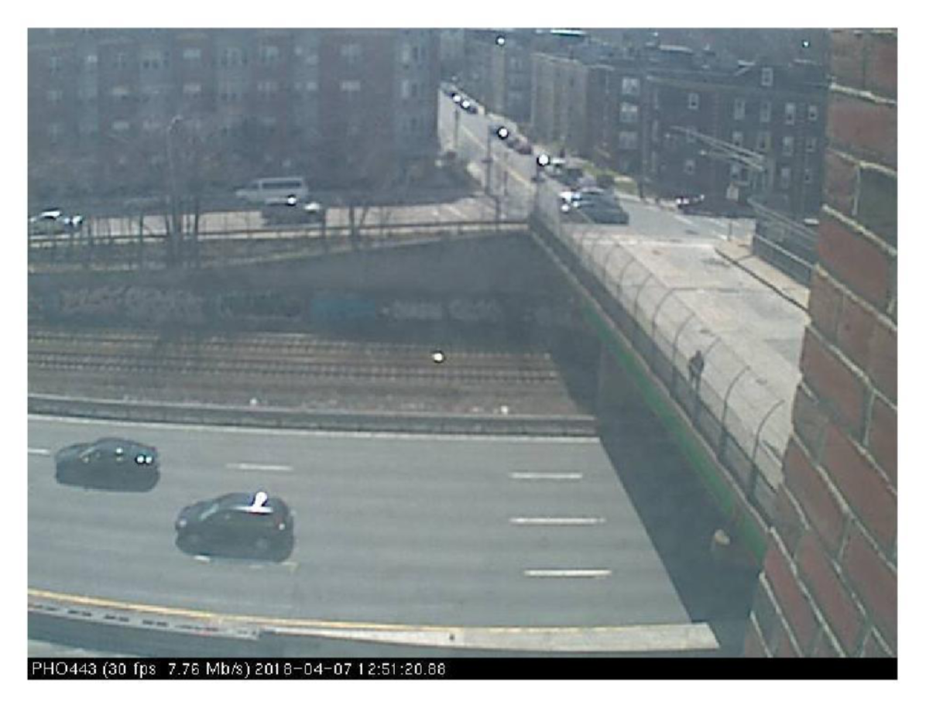
Problem Statement
Difficulty in managing traffic is increasing
Need to detect the vehicles and classify them
Distinguish between trucks and cars

Slide 3
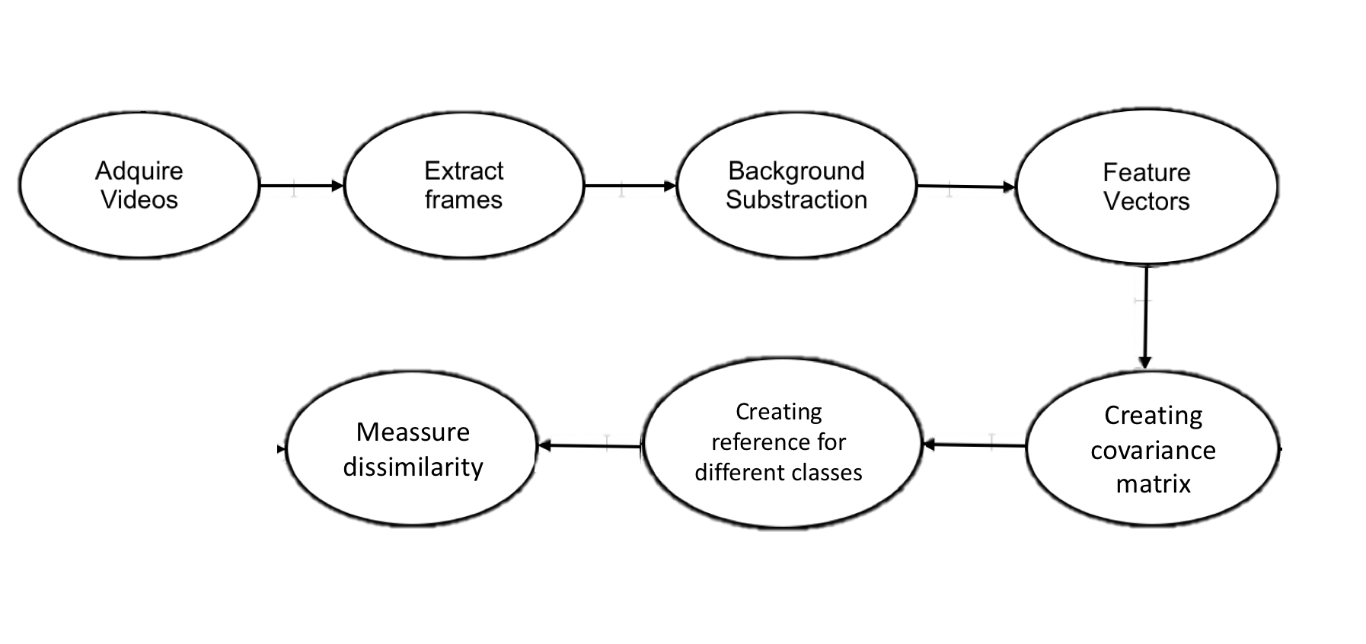
Project flowchart

Slide 4
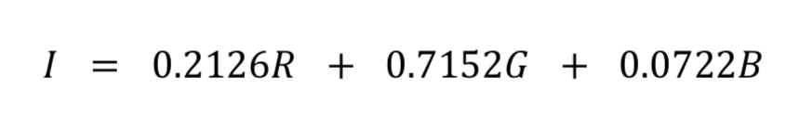
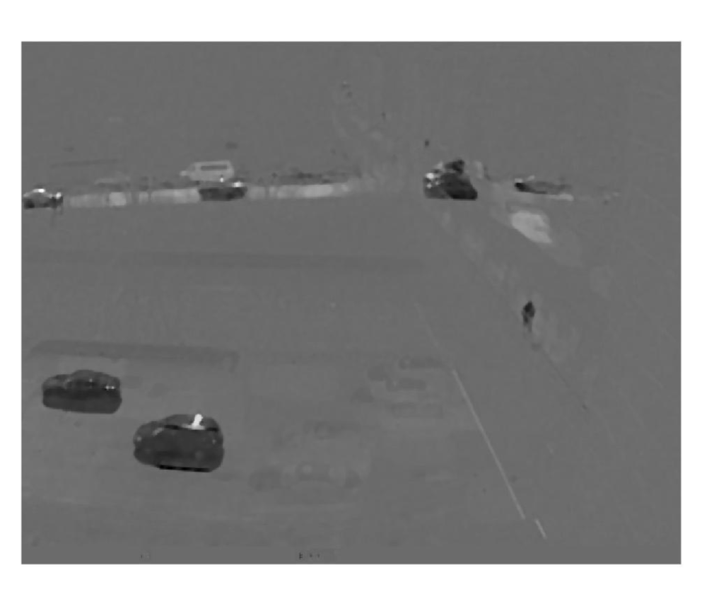
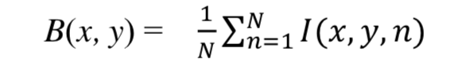
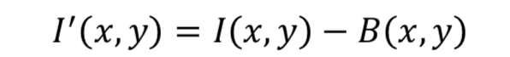
Background Subtraction
Implemented on a grayscale version of the images
Background obtained by mean
Background subtracted image

Slide 5
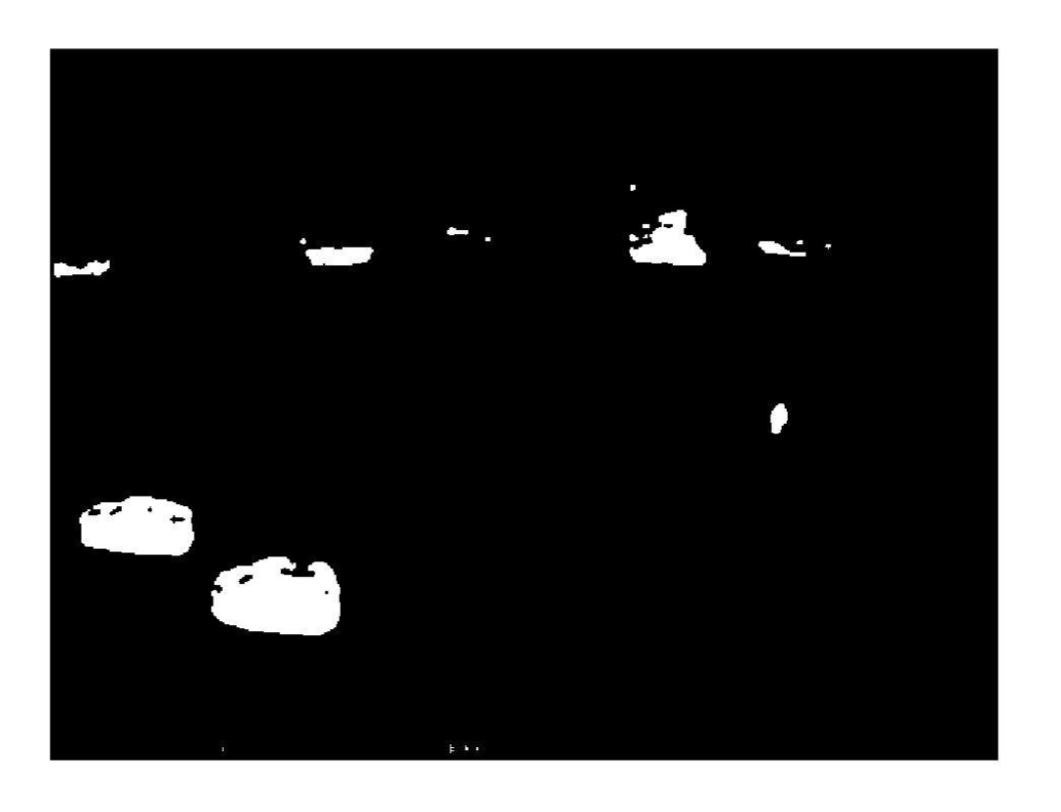
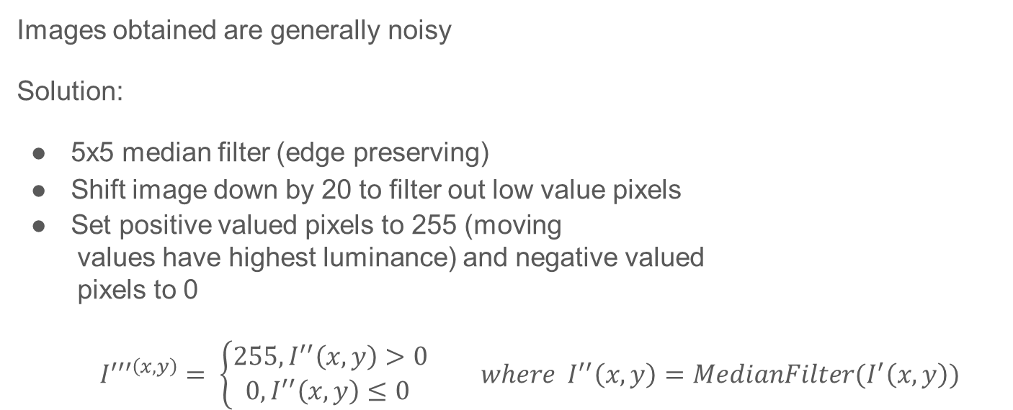
Background Subtraction
Images obtained are generally noisy
Solution:
5x5 median filter (edge preserving)
Shift image down by 20 to filter out low value pixels
Set positive valued pixels to 255 (moving
values have highest luminance) and negative valued
pixels to 0
$I^{′′′\left(x,y\right)}= \left\{\begin{aligned}255, I^{′′}\left(x,y\right)>0 \\ 0, I^{′′}\left(x,y\right)≤0 \end{aligned} \right. where I^{′′}\left(x,y\right)=MedianFilter(I^{′}\left(x,y\right))$

Slide 6
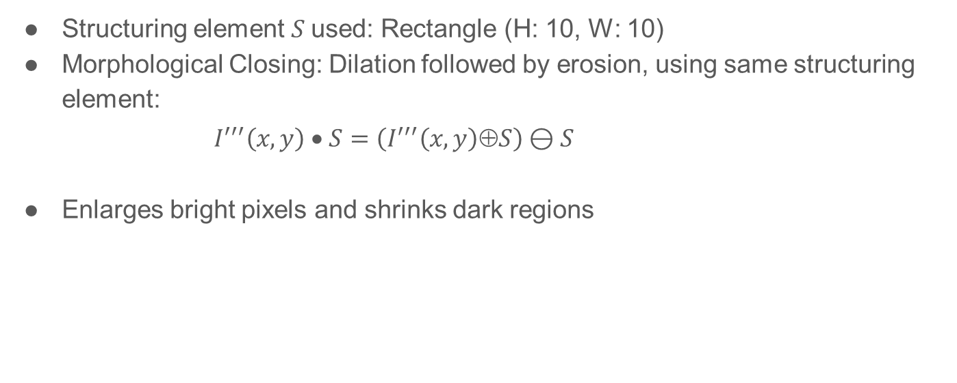
Background Subtraction – using morphological operators
Structuring element $S$used: Rectangle (H: 10, W: 10)
Morphological Closing: Dilation followed by erosion, using same structuring element:
$$I^{′′′}\left(x,y\right) • S=\left(I^{′′′}\left(x,y\right)⊕S\right)⊖S$$
Enlarges bright pixels and shrinks dark regions

Slide 7

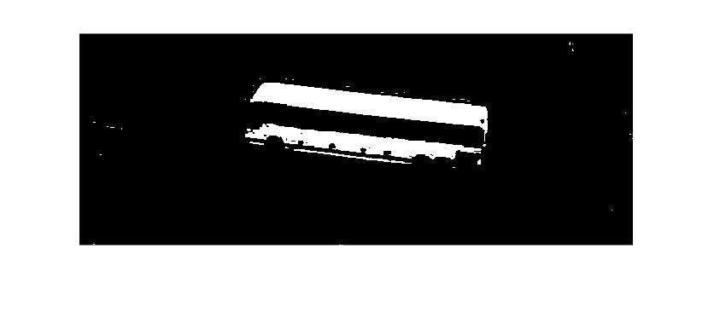
Comparison of background subtraction
After closing
before closing

Slide 8
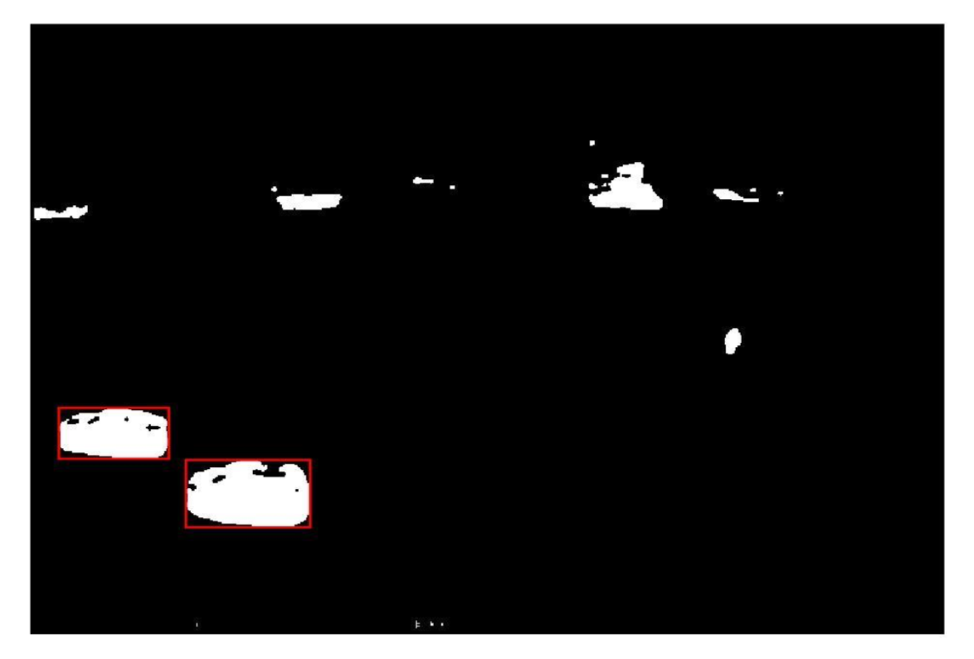
Background Subtraction
Bounding box (BWCONNCOMP)
8-connected neighbourhood
Flood-fill algorithm to label all the pixels in the connected component containing ‘x’
Drawn around all the connected groups with an area of above 2000px²
6.3 seconds for 20 images
Future improvements
Markov Random Field to prevent merging of close
vehicles

Slide 9
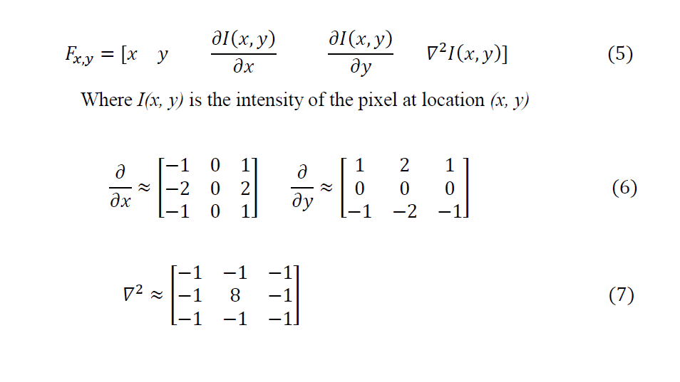
Feature Vectors

Slide 10
Covariance Matrix
Advantages over other feature descriptors:
Invariant to rotational and scale changes.
Natural way of fusing multiple features.
Low dimensional due to symmetry.

Slide 11
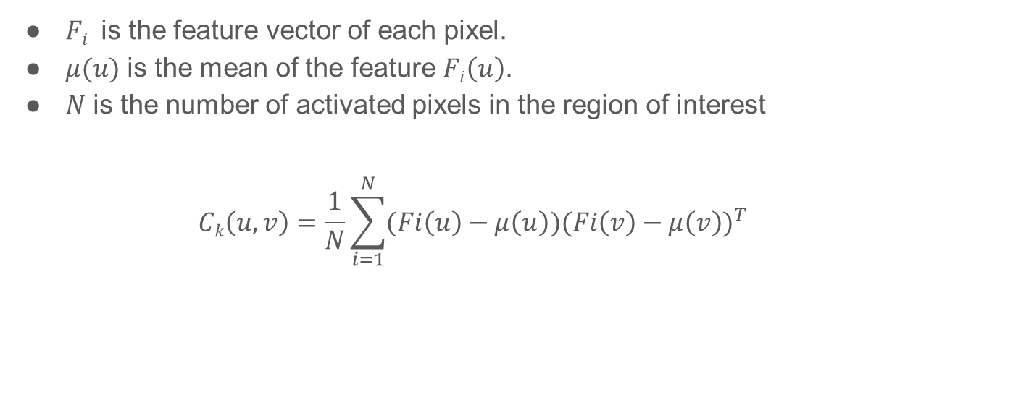
Covariance Matrix
$Fi$ is the feature vector of each pixel.
$μ(u)$ is the mean of the feature $Fi\left(u\right)$.
$N$ is the number of activated pixels in the region of interest
$$Ck\left(u,v\right)=\frac{1}{N}\sum_{i=1}^{N}{{(Fi\left(u\right)−μ\left(u\right))(Fi\left(v\right)−μ\left(v\right))}^{T}}$$

Slide 12
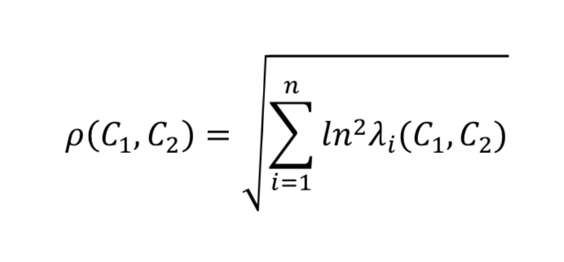
Class Creation and Nearest neighbor Classification
3 different classes will be created
{Car, Truck}
Region of interest Covariance compared against a library of Covariance Matrices.
Comparison done by using the following distance metric:

Slide 13
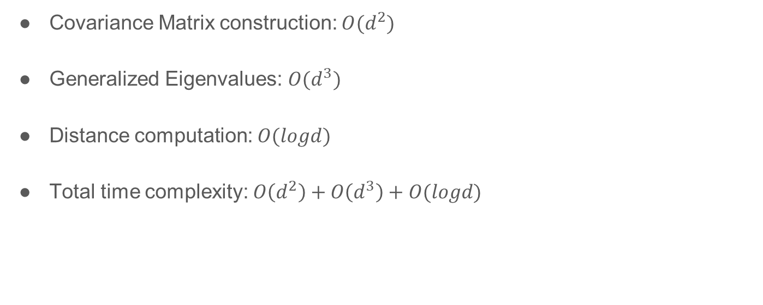
Total time complexity
Covariance Matrix construction: $O(d^{2})$
Generalized Eigenvalues: $O(d^{3})$
Distance computation: $O(logd)$
Total time complexity: $O\left(d^{2}\right)+O\left(d^{3}\right)+O(logd)$

Slide 14
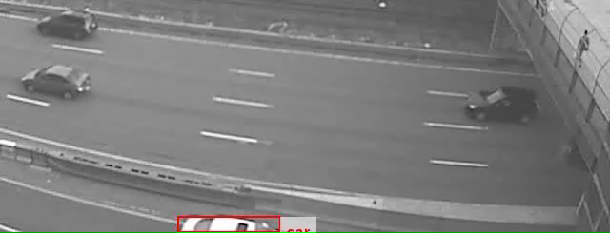
Demo
Demo

Slide 15
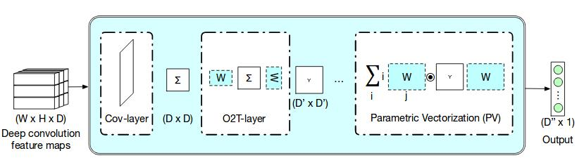
Future Work - Second Order CNNs
Handcrafted features are not robust for heterogeneous datasets.
Convolutional Neural Networks have been successful in extracting features.
Second order CNN can be designed to extract Covariance matrices from convolutional activations.
Basic SO-CNN architecture:

Slide 16
References
[1] F. Porikli, O. Tuzel, P. Meer. Covariance Tracking using Model Update Based on Means on Riemannian Manifolds. Proc. IEEE CVPR, 2006
[2] S. Bhattacharya, N. Souly, M. Shah. Covariance of Motion and Appearance Features for Human Action and Gesture Recognition. arXiv preprint arXiv:1606.05355v1, 2016
[3] O. Tuzel, F. Porikli, P. Meer. Region Covariance: A Fast Descriptor for Detection and Classification. ECCV, 2006
[4] K. Yu, M. Salzmann. Second-order Convolutional Neural Networks. arXiv preprint arXiv:1703.06817, 2017
[5] W. Forstner, B. Moonen. A metric for covariance matrices. Geodesy-The challenge of the 3rd Millennium, 2003

Slide 17
Thank you!

